Slide 1
International Federation of Surveyors
Fédération Internationale des Géomètres
International Vereinigung der Vermessungsingenieure
Welcome to a brief presentation of:
FIG - International Federation of Surveyors
2015

Slide 2
International Federation of Surveyors
Fédération Internationale des Géomètres
International Vereinigung der Vermessungsingenieure
What is FIG?
Established in 1878 in Paris by 7 member associations (Belgium, France, Germany, Italy, Spain, Switzerland and UK)
Federation of national associations
Only international body representing all surveying disciplines
UN-recognised non-governmental organisation (NGO)

Slide 3
International Federation of Surveyors
Fédération Internationale des Géomètres
International Vereinigung der Vermessungsingenieure
FIG Foundation
General Assembly
FIG Office
FIG Manager and
Co-ordinators
Council
President and 4 Vice-Presidents
ACCO
Advisory Committee
of Commission Officers
Commissions
Chairs and Vice Chairs
Networks
Chairs and members
Delegates and
correspondents
Task Forces
Chairs and Members
Permanent
Institutions
Director and members
National Delegates
Standards Network
Int. Office of Cadastre
and Land Records
OICRF
Correspondents
Young Surveyors
Network
History of Surveying
and Measurement

Slide 4
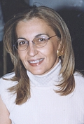
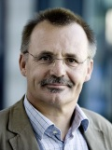


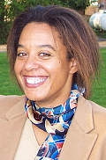
International Federation of Surveyors
Fédération Internationale des Géomètres
International Vereinigung der Vermessungsingenieure
FIG Council
Chryssy Potsiou
TCG (Greece)
President 2015-18
Rudolf Staiger
DVW (Germany)
Vice President
Bruno Razza
CNGeGL (Italy)
Vice President
PengFei Cheng
CSGPC (China)
Vice President
Diane Dumashie
RICS (UK)
Vice President

Slide 5
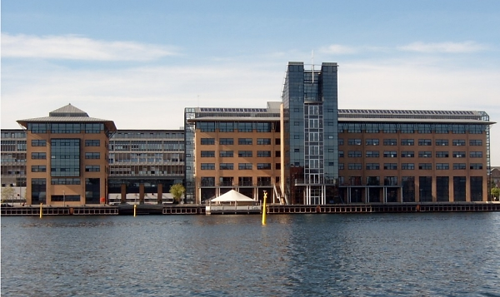



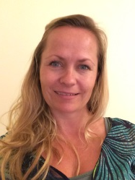
International Federation of Surveyors
Fédération Internationale des Géomètres
International Vereinigung der Vermessungsingenieure
FIG Office and administration
Complex housing the FIG Office, Copenhagen
Louise Friis-Hansen
FIG Manager
Hanne Elster
Events and Office Coordinator
Claudia Stormoen Pedersen
Office and Events Coordinator
Maria Bargholz
Book keeper

Slide 6
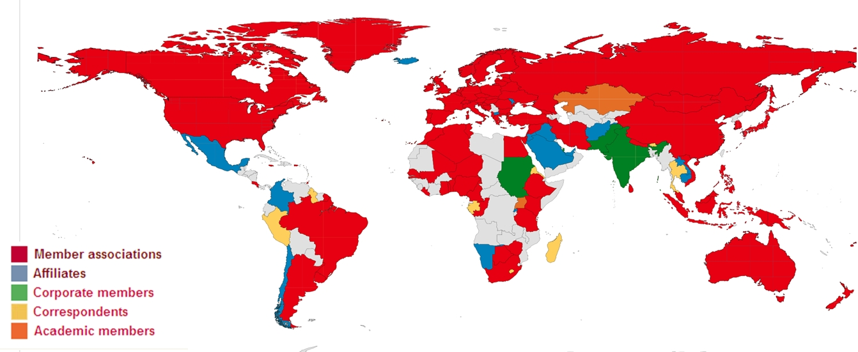
International Federation of Surveyors
Fédération Internationale des Géomètres
International Vereinigung der Vermessungsingenieure
Members
121 countries represented in 2015 – more than 300,000 individuals

Slide 7
International Federation of Surveyors
Fédération Internationale des Géomètres
International Vereinigung der Vermessungsingenieure
Members
Membership categories:
101 member associations from 88 countries
45 affiliate members from 43 countries
92 academic members from 58 countries
25 corporate members
1 correspondents
6 honorary presidents
32 honorary members

Slide 8

International Federation of Surveyors
Fédération Internationale des Géomètres
International Vereinigung der Vermessungsingenieure
FIG Foundation
Building a Sustainable Future
Provides grants and scholarships, promoting high standards of surveying education, encouraging research activities and promoting the exchange of young surveying personnel.

Slide 9
International Federation of Surveyors
Fédération Internationale des Géomètres
International Vereinigung der Vermessungsingenieure
Commissions
1. Professional Practice
2. Professional Education
3. Spatial Information Management
4. Hydrography
5. Positioning and Measurement
6. Engineering Surveys
7. Cadastre and Land Management
8. Spatial Planning and Development
9. Valuation and the Management of Real Estate
10. Construction Economics and Management

Slide 10
International Federation of Surveyors
Fédération Internationale des Géomètres
International Vereinigung der Vermessungsingenieure
Commission administration
Chair
Vice-chair(s)
Vice-chair of administration
Delegates - each member to nominate one
delegate to each of the commissions
Annual meetings
Workshops and seminars
Working groups

Slide 11

International Federation of Surveyors
Fédération Internationale des Géomètres
International Vereinigung der Vermessungsingenieure
Young Surveyors
To improve the number of young professionals participating within the FIG.
To help young professionals in the beginning of their careers with contacts.
To increase co-operation between the commissions and the students and young professionals network.

Slide 12
International Federation of Surveyors
Fédération Internationale des Géomètres
International Vereinigung der Vermessungsingenieure
Fédération des Géomètres Francophones (FGF)
Arab Union of Surveyors (AUS)
Comité de Liaison des Géomètres Européens (CLGE)
ASEAN Federation of Land Surveying and Geomatics (AFLAG)
Asociación Panamericana de Profesionales de la Agrimensura (APPA)
Mediterranean Union of Surveyors (UMG)
Pacific Association of Quantity Surveyors (PAQS)

Slide 13


International Federation of Surveyors
Fédération Internationale des Géomètres
International Vereinigung der Vermessungsingenieure
International cooperation
World Bank Group
United Nations Human Settlement Program (UN-Habitat)
Food and Agriculture Organization of the United Nations (FAO)
United Nations Global Geospatial Information Management (GGIM)
United Nations Office for Outer Space Affairs (UNOOSA)
United Nations Economic Commission for Europe (UNECE)
United Nations Economic Commission for Africa (UNECA)
United Nations Department of Economic and Social Affairs (UN DESA)
United Nations Conference on the Standardization of Geographic Names
United Nations Regional Cartographic Conferences (UNRCC)
Global Land Tool Network (GLTN) (UN-Habitat)
International Organization for Standardization (ISO)

Slide 14
International Federation of Surveyors
Fédération Internationale des Géomètres
International Vereinigung der Vermessungsingenieure
Communication
Annual Review
monthly e-Newsletter
Article of the month
commission newsletters
publications
congress and working week proceedings
Surveyors Reference Library
web site: www.fig.net
Social media

Slide 15
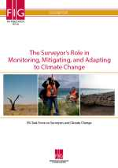
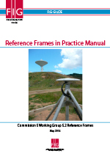
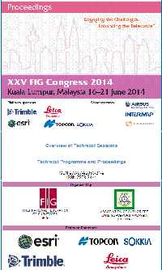
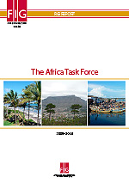
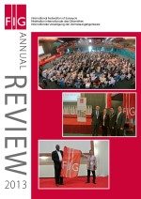
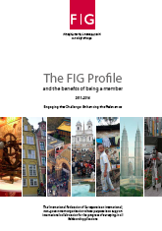
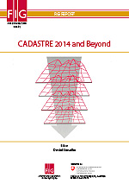
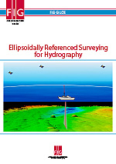
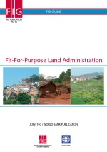
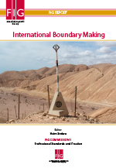
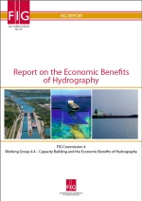
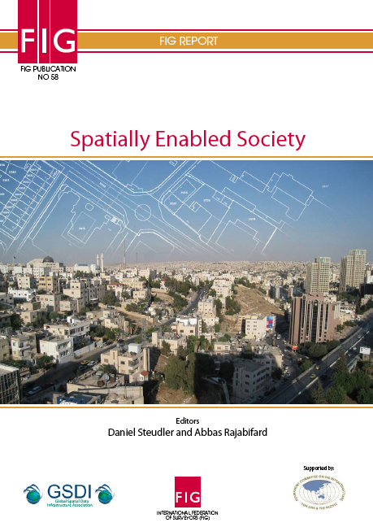
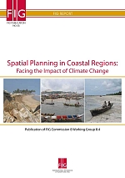
International Federation of Surveyors
Fédération Internationale des Géomètres
International Vereinigung der Vermessungsingenieure
www.fig.net

Slide 16


International Federation of Surveyors
Fédération Internationale des Géomètres
International Vereinigung der Vermessungsingenieure
FIG Events
FIG Working Week 2015
17-21 May, Sofia, Bulgaria
FIG Working Week 2016
2-6 May, Christchurch, New Zealand
FIG Working Week 2017
29 May – 2 June, Helsinki, Finland
FIG Congress 2018
6-11 May, Istanbul Turkey

Slide 17
International Federation of Surveyors
Fédération Internationale des Géomètres
International Vereinigung der Vermessungsingenieure

Slide 18
International Federation of Surveyors
Fédération Internationale des Géomètres
International Vereinigung der Vermessungsingenieure

Slide 19
International Federation of Surveyors
Fédération Internationale des Géomètres
International Vereinigung der Vermessungsingenieure

